Slide 1
WFIRST Coronagraph Photometry and Yield for Planet Imaging
Bijan Nemati
1/21/2016

Slide 2
Introduction
A simple analytical approach to calculating SNR and time to achieved a given SNR is presented.
This includes a detailed look at the categories of throughput loss contributions to the planet signal and to the background
Also included, for WFIRST coronagraph, is a detailed description of key quantities tabulated in John Krist’s contrast tables.
The presentation concludes with the time and SNR equations and example calculations.

Slide 3
Signal and Background Contributions
Assume take the signal to be the excess within the PSF core, defined as the footprint of the PSF contour at FWHM.
We would like to consider three contributions:
Signal
Star (speckle) Background
Zodi Background
PSF core
planet
speckles
zodiacal dust

Slide 4
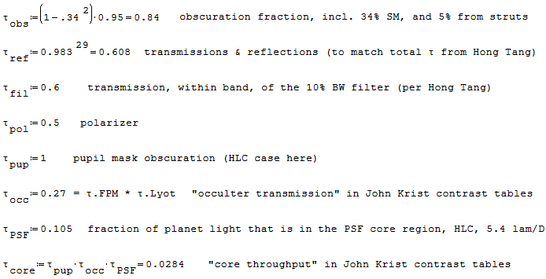



Coronagraph Throughput Contributions
Telescope
T2
T1
COR F1
M3
COL F1
COR F2
M4
COL F2
Collimator Bench
Pupil mask
Focal Plane mask
Lyot
mask
Field stop
mask
Filter
wheel
IFS/Img Selector
FSM
Coronagraph Bench
R1 OAP2
DM1
R2 OAP2
R1 OAP1
FocM
FPA
DM2
R2 OAP1
FM
R3 OAP1
R3 OAP2
FS OAP1
FS OAP2
Radiation Shield Mirror
to LOWFS
PBS

Slide 5
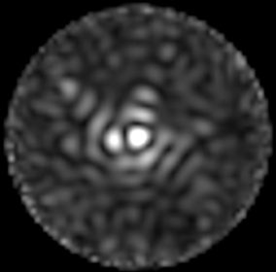
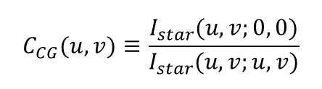

Coronagraph Contrast
The Coronagraph contrast is computed on a per pixel basis.
Steps to getting contrast at $(u,v)$
Propagate a flat wavefront (corresponding to the star being at 0,0) through the optical system, from the primary all the way to the imager
Obtain the intensity distribution $I(u,v;0,0)$ in the focal plane
Normalize the intensity distribution to the total incident power (photons/second) incident on the unobscured parts of the primary.
Repeat with a tilt applied to the incoming wavefront so that the star is effectively at $\left(u,v\right)$ → this gives $I(u,v;u,v)$
Divide the intensity distribution in step 2 by the PSF peak in step 3
OWA
evaluate
source
IWA ~ 3 λ/D
(0,0)
$$C_{CG}(u,v)≡\frac{I_{star}(u,v;0, 0)}{I_{star}(u,v;u,v)}$$
Dark Hole with Speckle
(u,v)

Slide 6
Using the Coronagraph Contrast Tables
The HLC polx and PIACMC tables include the attenuation (throughput loss)
due to the polarizer for I, core_thruput, PSF_peak, and occ_trans
so, to calculate the mean speckle level, the throughput
Below are excerpts from two contrast table files for the HLC design
---------------------------------------------------------------------------------------------------------------------------
r(lam/D) r(arcsec) I contrast core_thruput PSF_peak area(sq_arcsec) occ_trans
---------------------------------------------------------------------------------------------------------------------------
............. hlc_20140623-139_0.4mas_jitter_results.txt ................................................................
3.00000 0.143602 1.1689422e-11 3.8758899e-09 0.022367177 0.0030159324 0.0020705070 0.39442343
3.30000 0.157962 6.6227517e-12 1.5575568e-09 0.030859951 0.0042520129 0.0020109240 0.39442343
5.40000 0.258484 4.5271587e-12 7.9960251e-10 0.041660457 0.0056617615 0.0020556112 0.39442343
............. hlc_20140623-139_0.4mas_jitter_results_polx.txt ...........................................................
3.00000 0.143602 1.6973625e-12 1.1255972e-09 0.011183589 0.0015079662 0.0020705070 0.19721172
3.30000 0.157962 1.5311561e-12 7.2020295e-10 0.015429976 0.0021260064 0.0020109240 0.19721172
5.40000 0.258484 1.1051182e-12 3.9037963e-10 0.020830229 0.0028308807 0.0020556112 0.19721172
...........................................................................................................................
Reductions due to reflections, CCD QE are omitted. Coronagraph mask throughputs
are included. Polarizer reduction is included as noted below.
> I = mean speckle intensity at r, normalized to flux incident on primary
> contrast = I(r) / PSF_peak(r)
> core_thruput = fraction of light incident on primary that makes it into the FWHM region of a field PSF centered at r
> PSF_peak = fraction of light in peak pixel of field PSF centered at r normalized to flux incident on primary
> area = area of the FWHM region of the field PSF centered at r
> occ_trans = occulter * lyot stop transmission at r
> Pixel sizes (for I, PSF_peak): hlc, piaacmc = 0.3 lam/D, spc = 0.2 lam/D
> Reduction by 0.5 due to polarizer included in HLC polx and piaacmc values for: I, core_thruput, PSF_peak, and occ_trans
...........................................................................................................................
Documentation in setupAFTA.m

Slide 7
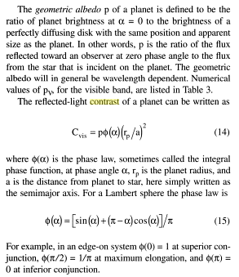


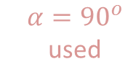


Planet Contrast
Planet contrast is independent of the instrument. It is simply the ratio of the flux arriving at the instrument aperture from the planet divided by the same from the star.
Traub & Oppenheimer
albedo
$$C_{pl}=P⋅φ\left(α\right)⋅{\left(\frac{r_{p}}{a}\right)}^{2}$$
Phase law
Exo system
LOS
$$a$$
$$r_{p}$$
$$α$$
(simple case of 90 deg inclination angle shown)
planet
$$α={90}^{o}$$ used
Observer
% Planet contrast C = albedo * phi(alpha) * (r_p / SMA)^2;
% phi(alpha) = (sin(alpha) + (pi-alpha)*cos(alpha)) / pi , where alpha = phase angle

Slide 8




Comparison of Contributions
Because of the way the coronagraph contrast is defined, the following differences apply to the photometric attenuation (“throughput”) factors that are applied to the various contributions
 | PSF | FPM | Lyot | Polariz | Pupil | Reflec | Filter
Planet
Speckle | 1
Zodi | 1
HLC Pol-x Example
example: for 47 UMa c, at 5.4 $λ/D$:
$≡$ Needs to be included separately: it is NOT in the contrast table

Slide 9
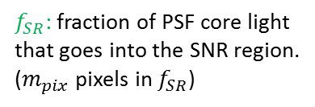
Old formula : Requisite Time to reach Goal SNR
Accounting for the EM gain, the ENF and the CIC, the expression for the SNR can be written as:
$f_{SR}$: fraction of PSF core light that goes into the SNR region. ($m_{pix}$ pixels in $f_{SR}$)
photonic
electronic
Can invert the equation to get the requisite time to get to a desired SNR:
Note that there could be no solution to t for sufficiently poor contrast!

Slide 10
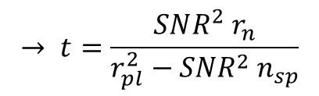

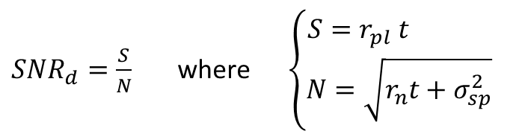
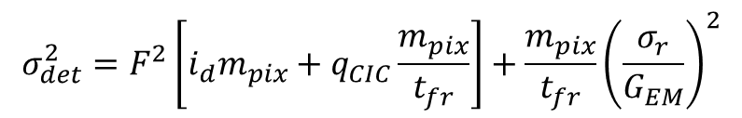

Corrections to the formula
The revised throughputs and contrast factors are highlighted
$SNR_{d}=\frac{S}{N}$ where $\left\{\begin{matrix}S=r_{pl} t \\ N=\sqrt{r_{n}t+σ_{sp}^{2}}\end{matrix}\right.$
$$r_{pl}=Φ_{∗} C_{pl} A_{PM} τ_{pl} η$$
$$r_{n}=F^{2}\left[{Φ_{∗} C_{pl} τ_{pl}+Φ}_{∗}C_{CG}I_{pk}m_{pix}τ_{sp}+\left(\frac{dΦ_{Z}}{dΩ} ΔΩ_{PSF}\right)τ_{Z}\right] A_{PM} η+σ_{det}^{2}$$
$${σ_{det}^{2}=F}^{2}\left[i_{d}m_{pix}+q_{CIC}\frac{m_{pix}}{t_{fr}}\right]+\frac{m_{pix}}{t_{fr}}{\left(\frac{σ_{r}}{G_{EM}}\right)}^{2}$$
$F≡$ EMCCD ENF
$σ_{sp}^{2}=n_{sp}t^{2}$ where $n_{sp}={\left(f_{pp}⋅Φ_{∗}C_{CG}I_{pk}m_{pix}τ_{sp}{ A}_{PM} η\right)}^{2}$
$$→ t=\frac{SNR^{2} r_{n}}{r_{pl}^{2}−SNR^{2}{ n}_{sp}}$$

Slide 11








Another Correction: Differential Imaging
The factor f_{pp} assumes speckles are somehow estimated
This estimation will bring with itself some errors – both random and systematic
For the random errors, this means there will be an extra contribution to noise
The simplest way is to assume a separate reference measurement (a la RDI) gives the speckle background
Angular differential measurement (ADI) would have a similar error
Either way, this means doubling of the variance for all terms except the signal shot noise
The noise rate changes to:
Target
Reference
$$P$$
$$B_{tar}$$
$$B_{ref}$$
Tar – Ref
(RDI)
$$P$$
$$S=S_{tar}−S_{ref}$$
$$=\left(P+B_{tar}\right)−B_{ref}$$
$$=P+\left(B_{tar}−B_{ref}\right)$$
$$δS=δP+\sqrt{2} δB$$
for the random background
$$r_{n}=F^{2}\left[2\left(Φ_{∗}C_{CG}I_{pk}m_{pix}τ_{sp}+\frac{dΦ_{z}}{dΩ}ΔΩ_{PSF}τ_{Z}\right)\right]A_{PM} η+2 F^{2}\left(i_{d}m_{pix}+q_{CIC}\frac{m_{pix}}{t_{fr}}\right)+2\frac{m_{pix}}{t_{fr}}{\left(\frac{σ_{r}}{G_{EM}}\right)}^{2}$$

Slide 12

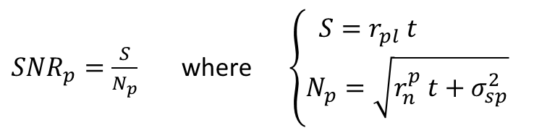
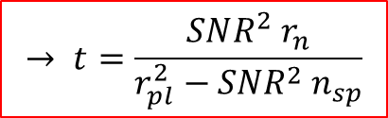

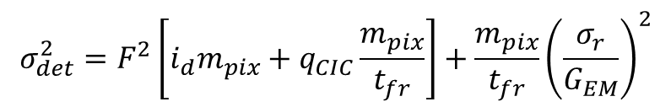
Revised SNR requisite time
Changes are in the throughputs, the factor 2 in the random error contributions, as the corrections to the speckle flux ratio:
$SNR_{p}=\frac{S}{N_{p}}$ where $\left\{\begin{matrix}S=r_{pl} t \\ N_{p}=\sqrt{r_{n}^{p} t+σ_{sp}^{2}}\end{matrix}\right.$
$$r_{pl}={f_{SR} Φ}_{∗} C_{pl} A_{PM} τ_{pl} η$$
$$r_{n}^{p}={f_{SR} F}^{2}\left[{Φ_{∗} C_{pl} τ_{pl}+2 Φ}_{∗}C_{CG}I_{pk}m_{pix}τ_{sp}+2\left(\frac{dΦ_{Z}}{dΩ} ΔΩ_{PSF}\right)τ_{Z}\right] A_{PM} η+{2 σ}_{det}^{2}$$
$${σ_{det}^{2}=F}^{2}\left[i_{d}m_{pix}+q_{CIC}\frac{m_{pix}}{t_{fr}}\right]+\frac{m_{pix}}{t_{fr}}{\left(\frac{σ_{r}}{G_{EM}}\right)}^{2}$$
Note that the factors of 2
may not apply if the reference is a composite of many observations, or a brighter reference star, or ADI
$σ_{sp}^{2}=n_{sp}t^{2}$ where $n_{sp}={\left(f_{pp}⋅Φ_{∗}C_{CG}I_{pk}m_{pix}τ_{sp}{ A}_{PM} η\right)}^{2}$
$$→ t=\frac{SNR^{2} r_{n}}{r_{pl}^{2}−SNR^{2}{ n}_{sp}}$$

Slide 13
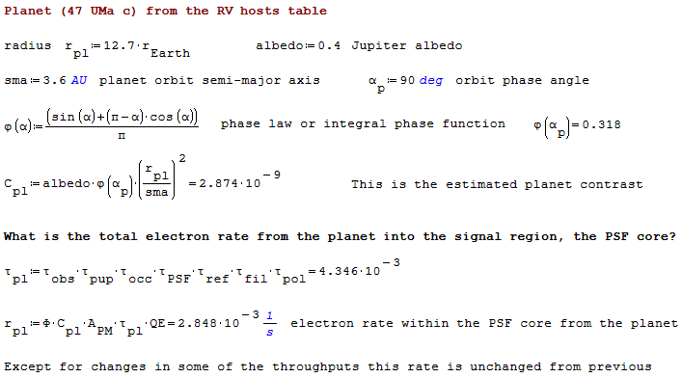
Example Calculation: Planet Signal
The planet signal is calculated by starting with the planet contrast and applying the attenuation from PSF core fraction

Slide 14
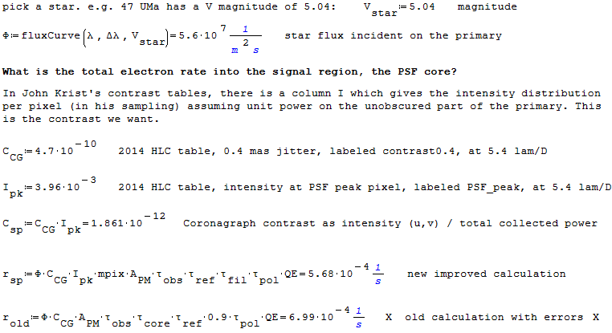
Example Calculation: Speckle Background

Slide 15
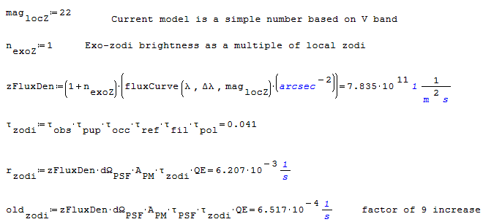

Example Calculation: Zodi Background
Zodi background is an extended source
The PSF core fraction $τ_{PSF}$ does not apply to Zodi

Slide 16
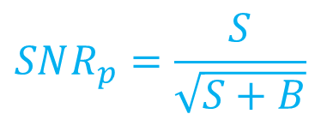
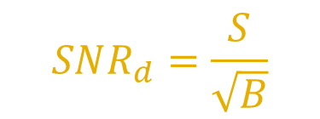
For future: Distinguish types of SNR
Should we distinguish between detection SNR and photometric SNR?
For planet detection, with the imager, we would be interested in detection SNR:
For spectrometry, with the IFS, we are interested in the photometric SNR:
$$SNR_{d}=\frac{S}{\sqrt{B}}$$
$$SNR_{p}=\frac{S}{\sqrt{S+B}}$$

Slide 17
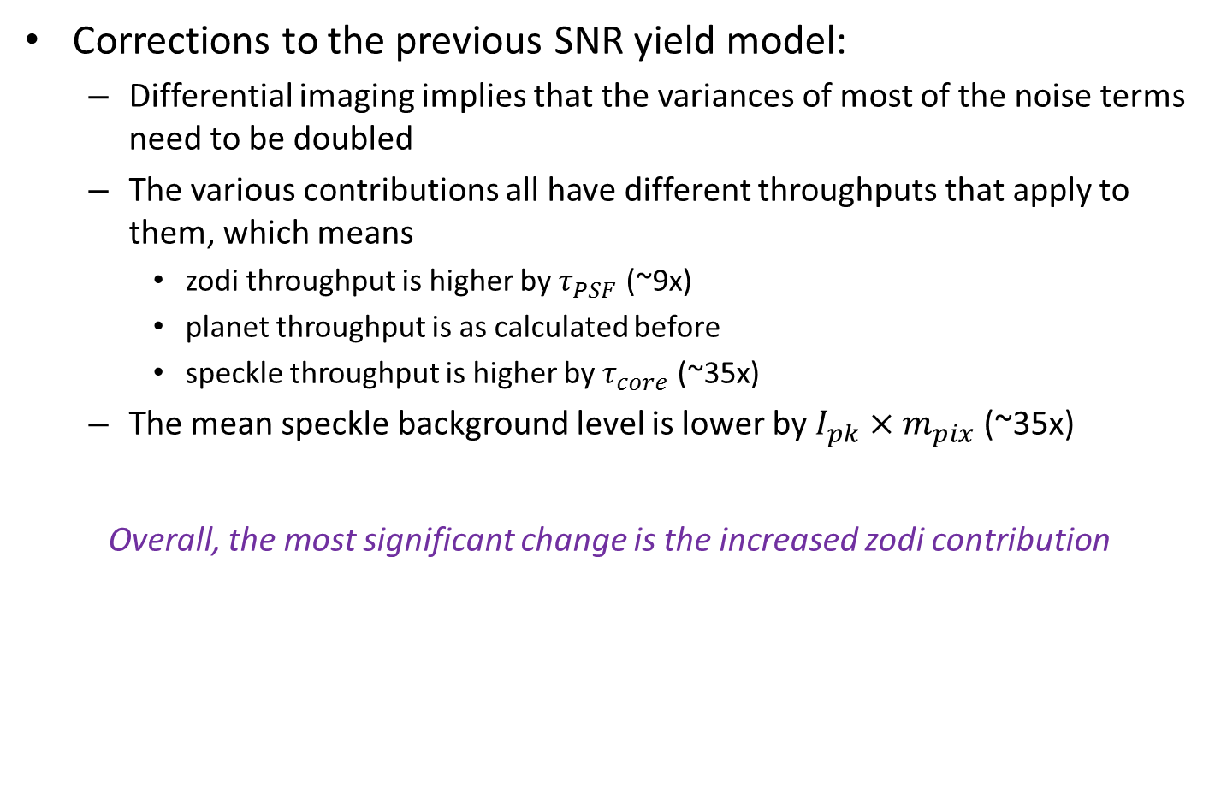
Summary
Corrections to the previous SNR yield model:
Differential imaging implies that the variances of most of the noise terms need to be doubled
The various contributions all have different throughputs that apply to them, which means
zodi throughput is higher by $τ_{PSF}$ (~9x)
planet throughput is as calculated before
speckle throughput is higher by $τ_{core}$ (~35x)
The mean speckle background level is lower by $I_{pk}×m_{pix}$(~35x)
Overall, the most significant change is the increased zodi contribution

